Slide 1

Housing Price Prediction
Amit Raj

Slide 2



Agenda
-Project Summary
-Technology Used
-Tools Used
-How it Works?
-What it does?

Slide 3
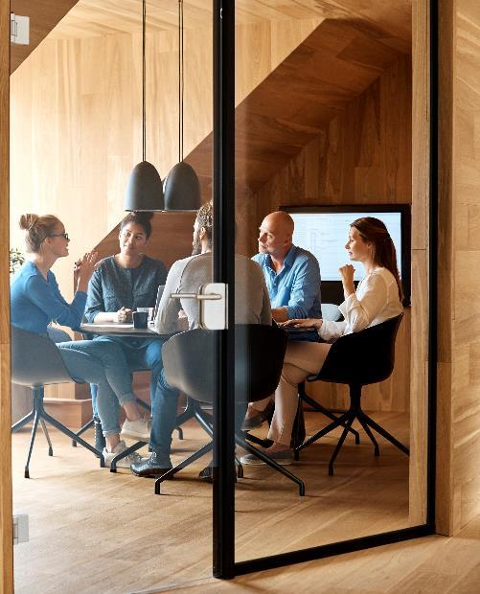



Introduction
With PowerPoint, you can create presentations and share your work with others, wherever they are. Type the text you want here to get started. You can also add images, art, and videos on this template. Save to OneDrive and access your presentations from your computer, tablet, or phone.

Slide 4


Introduction
Problems faced during buying a house:
Buying house is stressful.
Buyers are generally not aware of factors that influenced the house price.
Many problems are faced during buying a house.
Hence real estate agents are trusted with the cummuication betwwwn buyer and seller as well as laying down a legal contract for the transfer. This just creates a middle man and increases the cost of house.

Slide 5
They Believe that I depend upon : 1. The square foot area 2. Neighbourhood 3. The no. of bedrooms
But I depends upon so many factors ..such as:
No of storeys.
Area outside the House.
Rooms on one floor.

Slide 6

Project Summary
-Our projects is amachine learning app, based on certain specification of your future Home it will try to guess the most accurate Price.
-Information such as state ,city ,area,stores.

Slide 7
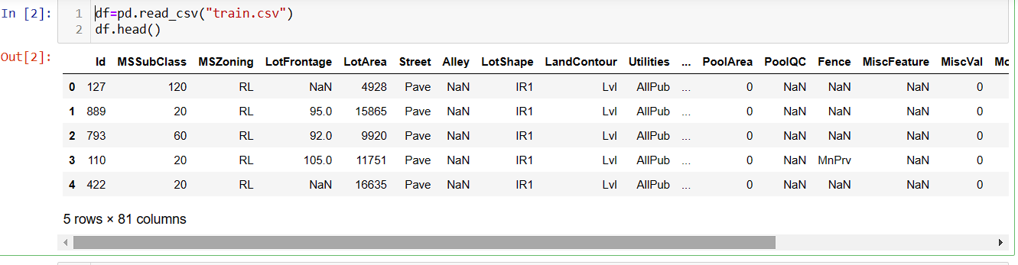
Loading the dataset In Pandas DataFrame

Slide 8
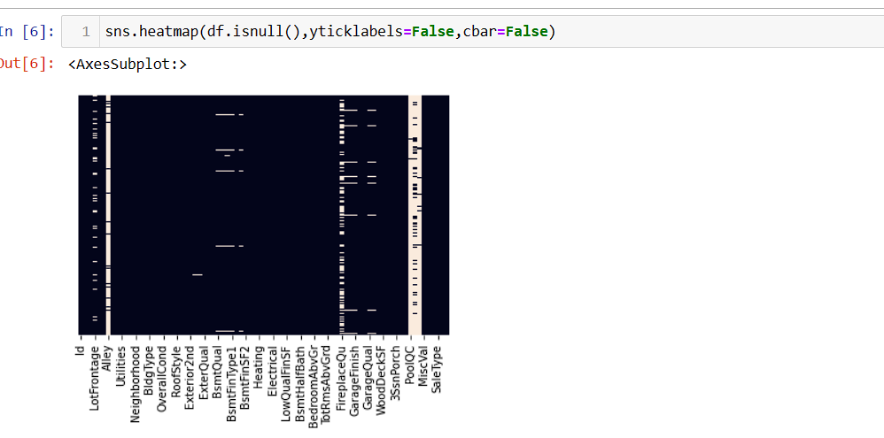
Checkin Null With help of the Heatmap

Slide 9
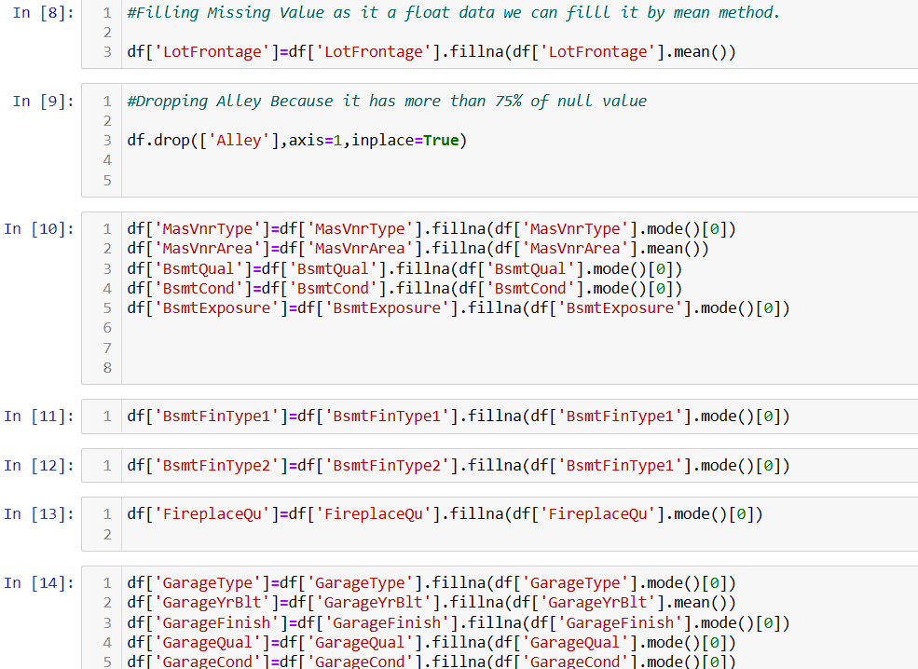
Filling the Null Value with the help of column.

Slide 10
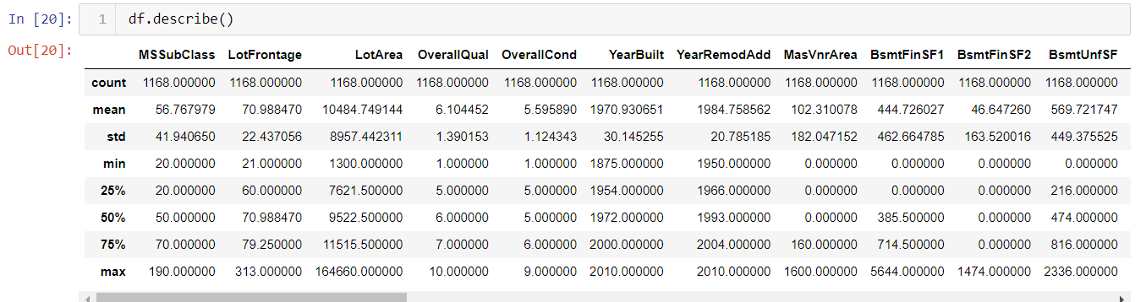
Checking The Data

Slide 11
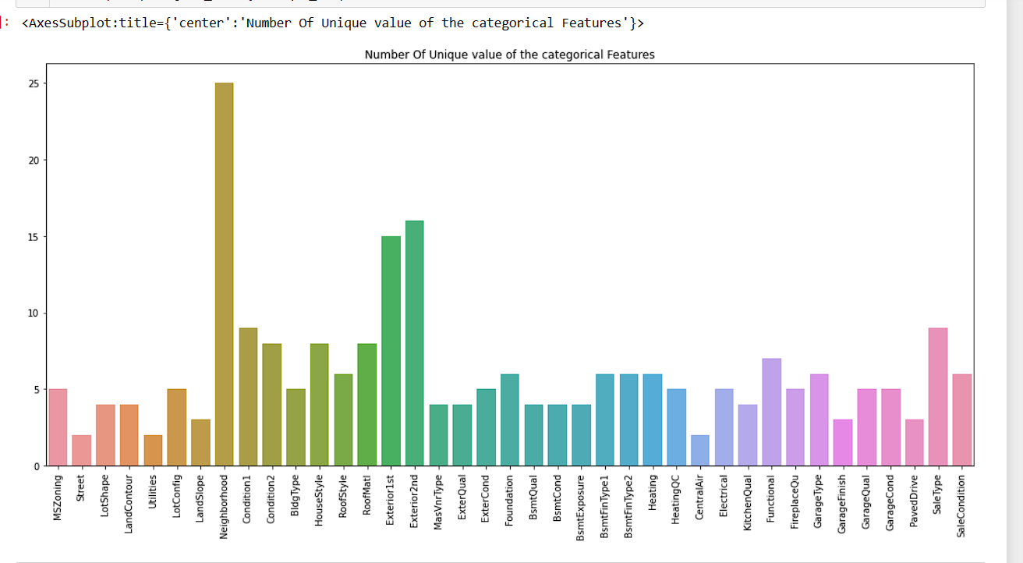
Barplot to check the No. of unique value in Categorical Data.

Slide 12
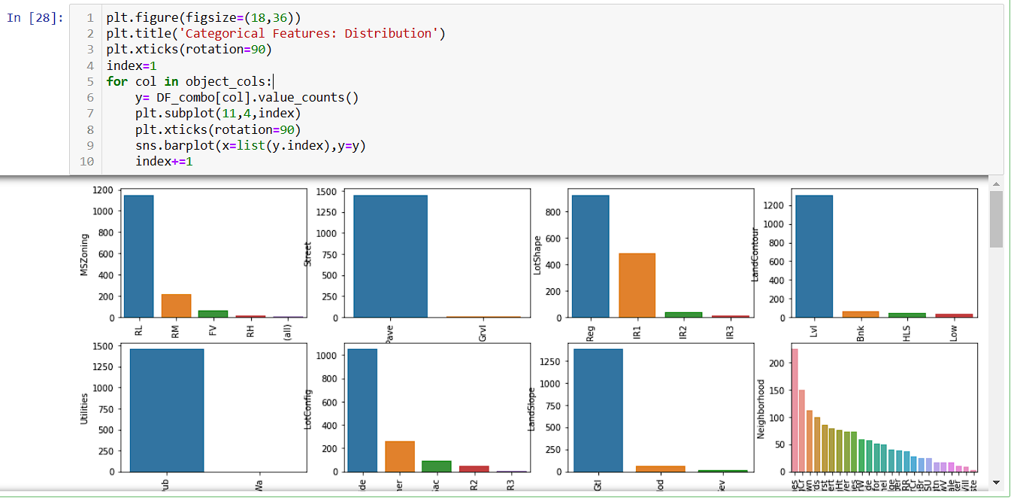

Slide 13
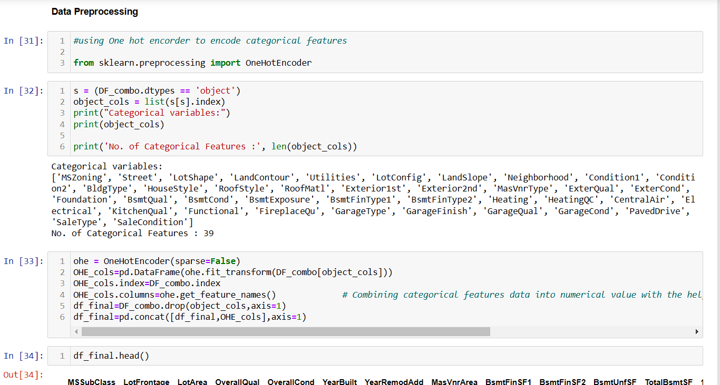

Slide 14
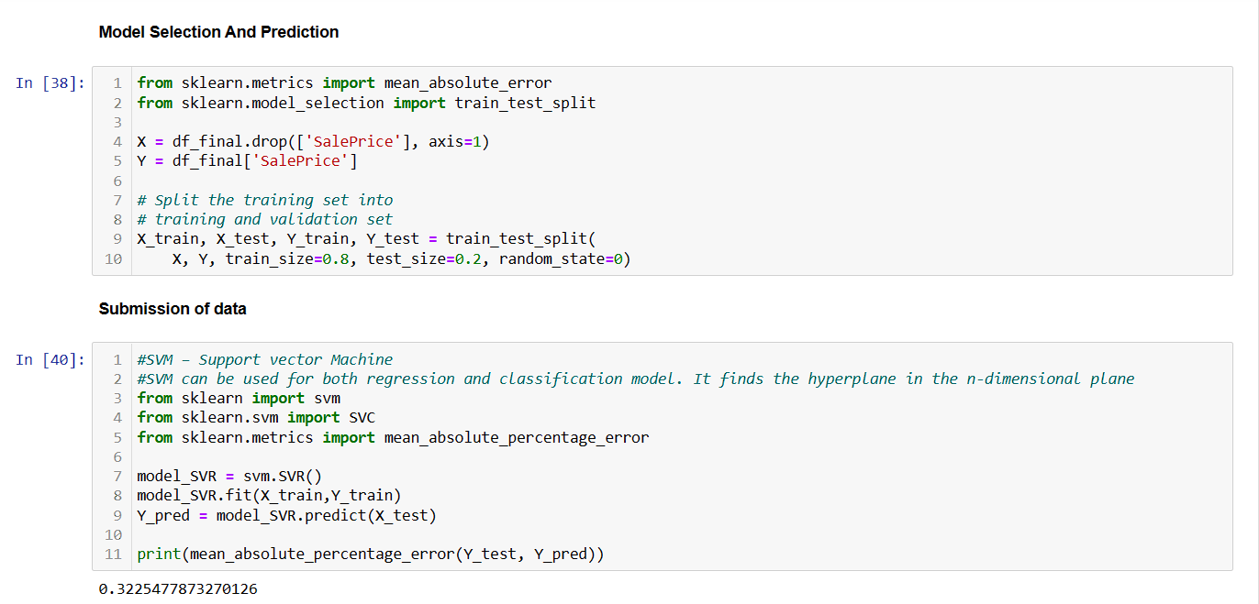

Slide 15
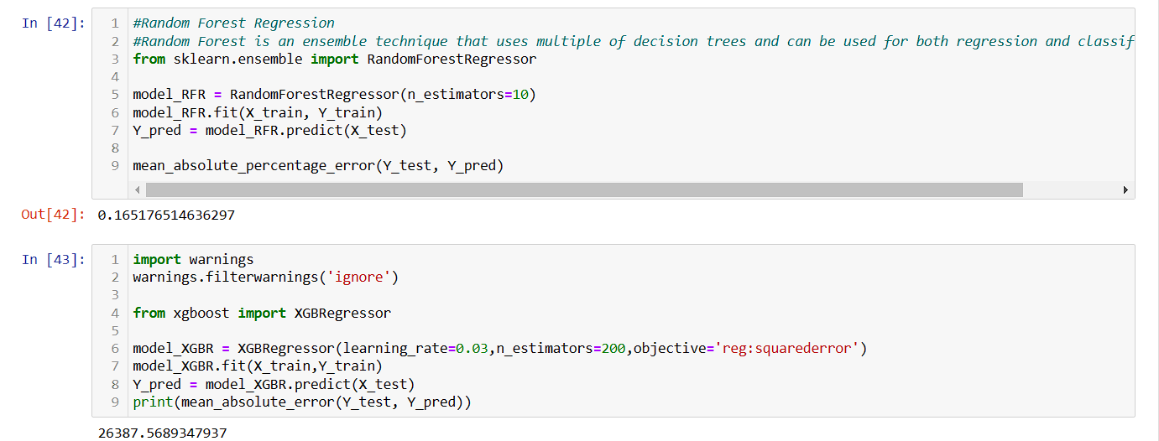

Slide 16
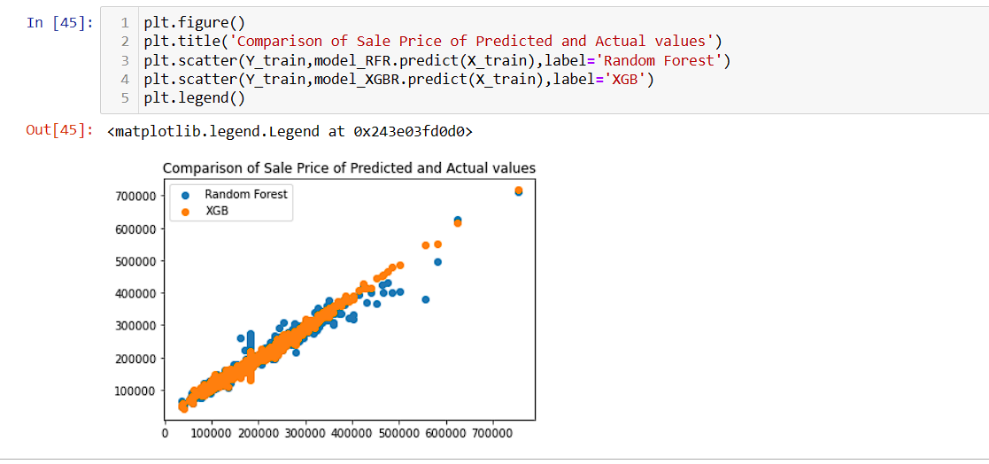

Slide 17
